Slide 1


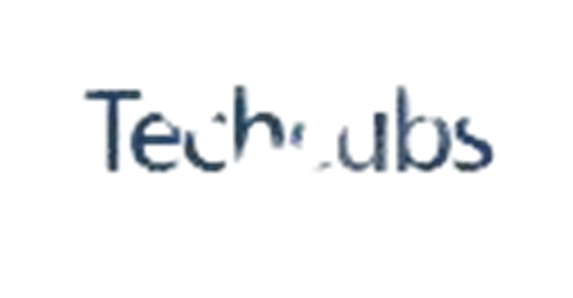

THE DYNAMO GROWTH CAMPAIGN
FOR TECHCUBS DIGITAL CONSULTS

Slide 2

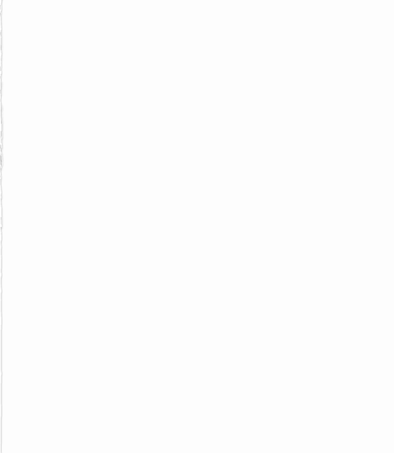

MEET THE DYNAMO TEAM
Akinduyi KOLAWOLE – Market Research Analyst
Ezeogu JUSTINA – Brand Auditor
Faniyi Adebayo BABAJIDE – Web Auditor/SEO
Omovwe TEGA – Web Auditor/SEO
Okon Nyong IBIANGAKE – Marketing Strategist
Onaiwu Elizabeth NOSAYABA – Marketing Strategist
Awonuga Michael OYEBODE – Financial Administrator

Slide 3
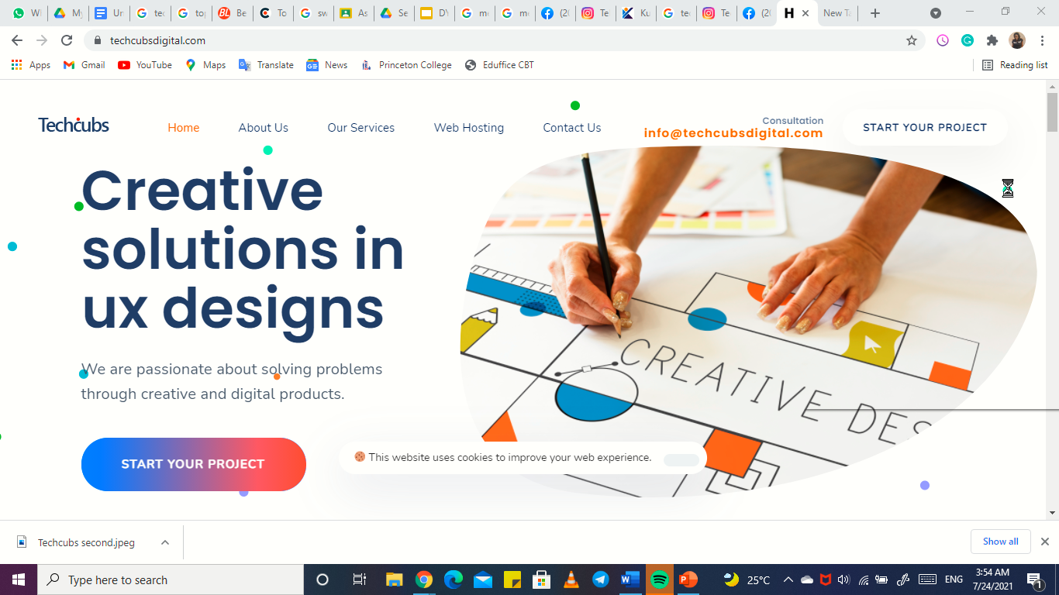
BRAND SUMMARY
Techcubs is a creative design agency in Lekki, Lagos that is passionate about creating world – class digital products for start ups and established brands.
Techcubs is a digital consulting company that offers services as follows
Branding/graphic designs,
UI/UX Designs for mobile apps and web apps,
Product designs and
Social Media Management

Slide 4

PROJECTS BY TECHCUBS
Nexa Mobile App (A payment app)
Sports Nutrition (branding)
Photo Retouching (branding)
Soda-Licious (branding)
Ams Energy (Web design)
Inspiration Board (Custom Print)
Mercedes-Benz Coupe (custom print)
Nite Shopping (branding)

Slide 5


HOW DO WE SEE THE BRAND
The website takes some time to load (the size of images seem too large)
The cookies alert does not disappear after clicking on it
Social media icon’s links don’t function from the website.
Inconsistent branding and brand colour (logo on website is different from that of Facebook)
Infrequent and inconsistent posting on social media
Low awareness and engagement on social media
Their tone of voice seems informal, they may not be targeting the right audience.
Posts on social media need more variety, they seem too monotonous.

Slide 6
COMPETITOR’S ANALYSIS
NAME/DIGITAL CHANNELS | PROS | CONS
Acumen Digital – Maryland, Lagos and Johannesburg. www.acumen.com.ng Website, Facebook, Instagram, Twitter, Linked In, Medium, GMB, Blog | The have a lot of backlinks on their website: 3.1K Fast and user-friendly website Award-winning company Memorable logo and branding Professional content | Icon links for Facebook, Instagram, Twitter don’t work from the website. Low engagement on social media
2. Cowebplus Systems Solutions – Lekki, Lagos. www.cowebplus.com Website, Facebook, Instagram, Twitter, GMB, Blog | Awareness on Instagram- almost 3000 followers. They are featured on 7 other business marketing sites. | Low engagement on social media
CKDigital – Ojota, Lagos. www.ckdigital.com Website, Facebook, Instagram, Twitter, Linked In, YouTube, GMB, Blog | A lot of traffic and backlinks on their website – 14,200 Fast website with good SEO Good presence on Social media about 7,500 followers on FB and IG

Slide 7
COMPETITOR’S ANALYSIS
NAME/DIGITAL CHANNELS | PROS | CONS
4. Hyfig Digital Services – Maryland, Lagos. www.hyfig.com Website, Facebook, Instagram, Twitter, Linked In, GMB, Blog | The have 4600 backlinks and a lot of relevant keywords Good branding colour and logo | GMB is not easily accessible. It dos not show till you request for the address. Inconsistent posting and low engagement on social media platform
5. Wow Effect Communications – Maryland, Lagos. www.woweffect.com.ng Website, Facebook, Twitter, Instagram, Linked In, GMB, Blog | Good graphics and animation on the website Have worked with big brands such as Vitafoam, Casio, Epson, etc. | Low engagement on social media Icon links for Instagram does not work from the website.

Slide 8
SWOT ANALYSIS
Based on reviews from past clients and past projects, the company is good at creating logos, brand and product designs. They have good eyes for colors. | Inconsistent posts, low brand awareness and engagement on social media. May not be attracting the right audience with the tone of voice on their content. Website is not optimized and FB and IG is not accessible from the website. It also takes time to load and Google is unable to crawl it.
We need to use email marketing (newsletters) to remain in the minds of potential customers and also to retain our customers. We need to focus on putting out value; educational and informational content to attract and engage leads/customers. This way we can have more awareness and engagement. | Their competitors have won awards, worked for multinationals and big brands Techcubs needs to reposition their company to attract such. Competitors have Linked In accounts and blogs.
STRENGTHS
WEAKNESSES
OPPORTUNITIES
THREATS

Slide 9
TARGET AUDIENCE PROFILING
Techcubs make websites logo and offer branding services to start ups which could mean entrepreneurs from the age of 20-55
Also, they sell website, branding and social media management to established brands and corporate offices, our target audience would be Businessmen ranging from age be from 25-65
Industry type: start ups and corporate offices (IT, Bank, Food, Telecommunications, fashion, entertainment, education provider, Fintech, real estate, oil and gas, etc.)
Type of customers (B2B and B2C)
Region: Lagos- Island and mainland, Nigeria.

Slide 10
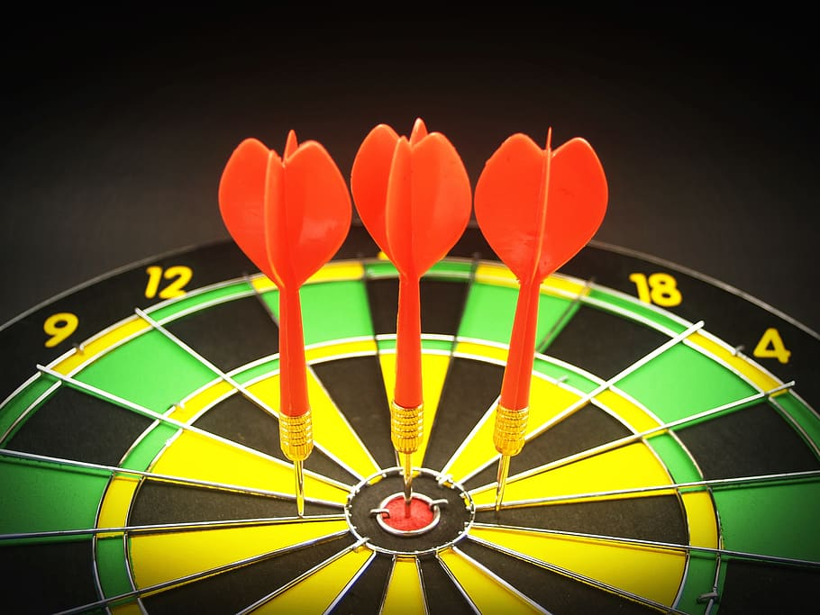
SMART GOALS
BASIC GOALS
Increase brand awareness
Increase website visibility
Generate leads and retain customers
To drive brand awareness and increase engagement across all our digital platforms and generate 20,000 leads and grow our email list to 500 subscribers. Also, we aim to increase organic website traffic by 30% all in the next three months.
DIGITAL CHANNELS
Website, Facebook, Instagram, GMB
TO BE CREATED
Linked In
Blog

Slide 11
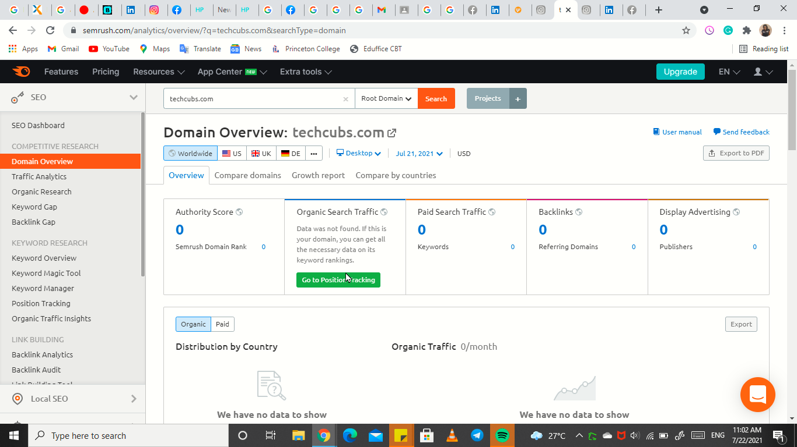
WEBSITE AUDIT
The website takes some time to load, the size of the product pictures seems too large, the social media icon links are not redirecting to the handles.
When we analyzed the website on SEMrush, we were unable to get data on it which means Google cannot crawl the website. To fully optimize Techcubs’ website, we will need a web developer and a copywriter. We need to rewrite and optimize the metadata framework and the content with keywords which our target audience are searching for so that the website can rank highly on Google’s search results. We need to work on adding backlinks to the website so that we can rank higher than our competitors and we will start by running adverts.
We will load the images in a smarter way so the website can be fast and user friendly and we will also adjust the social media links so that they can become functional.

Slide 12
KEYWORD ANALYSIS
KEYWORDS FROM ANALYZING OUR COMPETITOR’S WEBSITE
Questions to ask before starting a ux design, ui ux questionnaire, digital agency lagos, branding companies in lagos.
Social media agency in lagos, digital marketing company in lagos, web designer in lagos Nigeria, website developers in Nigeria, website design company in lagos, web design agency in lagos, top web designers in nigeria,
Top social media sites in Nigeria, digital agency lagos, social media statistics in Nigeria.
KEYWORDS FROM GOOGLE KEYWORD PLANNER
UX design, UI design,
UIUX design, user interface design
Digital marketing agency, marketing agency
Digital marketing company, branding, branding agency
Brand design, corporate branding, digital marketing freelance, social media marketing agency, social media marketing services, best web design company in lagos
Top 10 web designers in Nigeria, web design company
Web development company, branding companies in Nigeria
Branding companies in lagos, branding and packaging companies in Nigeria
Design consultation, graphic design consultation.

Slide 13
WEBSITE OPTIMIZATION (ABOUT US)
ABOUTUS (OLD)
Now is about change and disruption. It’s about the end of old certainties and the beginning of new opportunities. But if that’s now – what’s next? We believe what’s next is in the hands of people living in a digital world. Digital empowers people. They decide what they love, where they engage and what they support. They are connected and in control. Your challenge – and ours – is to embrace that.
When it comes to digital and creativity, we’re unapologetic optimists. We’ve only scratched the surface of what’s possible. Next comes accelerating growth through the possibilities of creative and digital experiences that merge imagination and technology in captivating new ways.
ABOUTUS (OPTIMIZED)
We are Techcubs, the smart digital agency in Lagos and we are the leading provider of creative solutions in web design, UI UX design, branding and design consultation, we provide brand designs for both digital and traditional advert purposes. Our product and services offer our clients a wide variety of design solutions and saves time and money.
With our comprehensive knowledge of design methodologies, we offer our client innovative ways of idea conceptualization, design generation and branding strategizing which provide for professional and efficient handling of all design jobs, Techcubss is the top web designer in Lagos, Nigeria and one of the best branding companies in Nigeria.

Slide 14
GROWTH STRATEGY
SEO: We will use keywords that are ranking from our competitors Google Keyword planner to optimize our website and content across all our digital platforms. We aim to increase website visits and perform local SEO.
SOCIAL MEDIA MARKETING: we need to put out more brand awareness and engaging and content which will enable us have an hedge over our competitors if we succeed at this. Techcubs has 232 followers on social media currently, we aim to increase that to 600 in 3 months time.
-Run adverts on FB, IG, Linked In and Google ads.
-ensure social media handles are accessible from the website.
-Always refer people to visit the website and blogs.
-Feature content that add value
-Engage in copywriting/content writing using relevant keywords and hashtags
-Engage in copywriting/content writing using relevant keywords and hashtags
-Post more variety using a content calendar.
CONTENT MARKETING: Our focus is to give out valuable content and our content must have the right tone of voice that appeals to our target audience.
-Have a blog and start writing articles using our researched keywords.
-Featuring blog articles on social media with a ‘Read More’ link that takes them to the full article on the blog/website.
-Strategic advertising of our clients products and services using appropriate content.

Slide 15
GROWTH STRATEGY
EMAIL MARKETING: We want to retain our customers and potential customers till they lead to conversion.
-There will be a pop-up on the website to subscribe to our email list.
-There will be a webchat where mails can be entered before proceeding to chat.
-Free eBook and educational materials relevant to our target audience which they will drop their mails to download..
-free strategy session where they can state their requests and we will collect their mails in the process.
VIDEO MARKETING: we will make brand videos with people, motion graphics, images and voice over to project our clients products and services. In addition, we will use explainer videos and educational/how to videos to make our target audience understand why they need our services
Domain referral and backlinks: We will work on featuring our website on other business advertising websites to increase traffic and exposure.

Slide 16
BUDGET
PLATFORM | UNIT COST (N) | FREQUENCY DAYS) | TIME RANGE | SUMMATION
Facebook Ads | 5000 | 3 | 3 weeks | 45,000
Instagram Ads | 5000 | 3 | 3 weeks | 45,000
Google Ads |  | 3 | 3 weeks | 30,000
Linked In Ads |  | 3 | 3 weeks | 45,000
Video | 50,000 | One-off |  | 50,000
Web Developer | 50,000 | One-off |  | 50,000
Email Marketing | 5000 | monthly | 3 months | 15,000
Service Charge |  |  |  | 350,000
TOTAL |  |  |  | N585,000

Slide 17
THANK YOU

